Slide 1
HPC
NAMAN ANAND

Slide 2
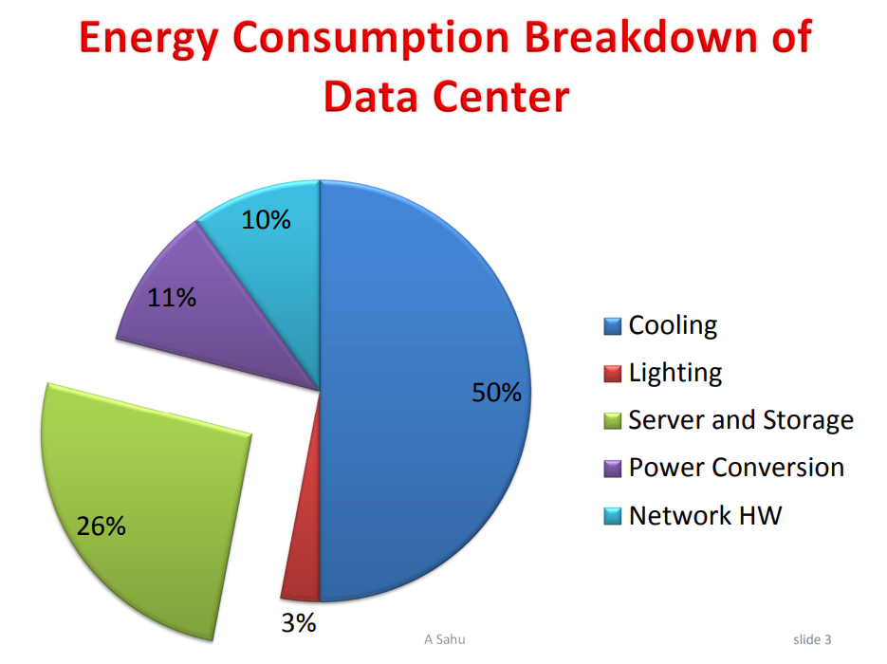
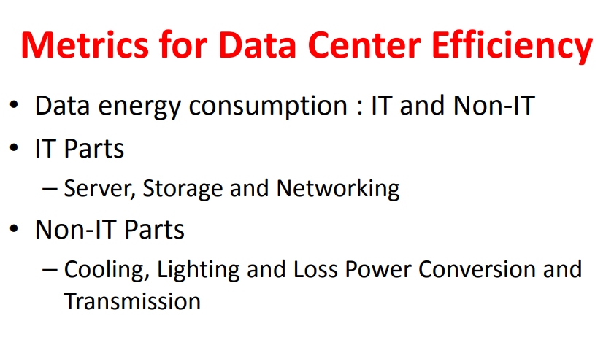
LEC 25
Breakdown shows :
More than equal to half is invested on cooling
Then Server and storage
IT PARTS :
SERVER
STORAGE
NETWORKING
NON IT PARTS :
COOLING
LIGHTING
LOSS POWER CONVERSION
TRANSMISSION

Slide 3
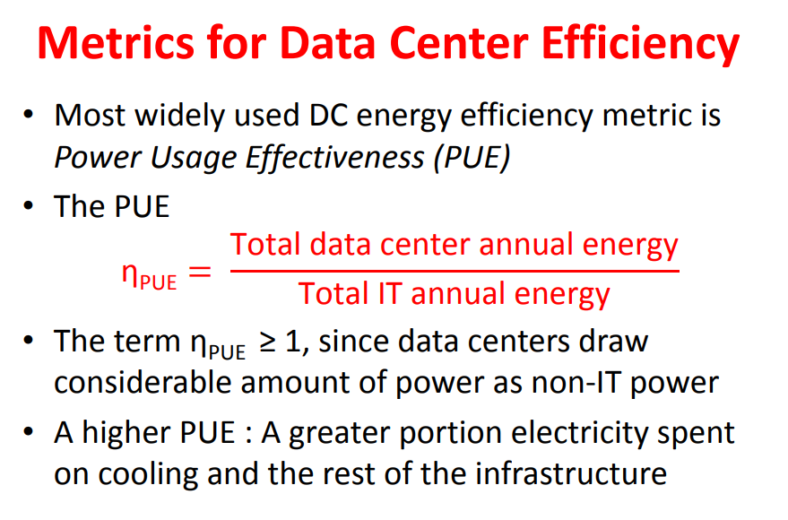
DATA CENTER :
WANT TO INVEST ON IT PARTS NOT ON NON IT PARTS
EFFICENCY METRIC : TOTAL/IT
PUE : POWER USAGE EFFECTIVENESS
HIGHER PUE : IT SPEND MORE ELECTRICITY ON COOLING AND REST
The calculation of power usage effectiveness is total facility power/IT equipment energy = PUE. Total facility power is the amount of power the facility uses, which includes all data center hardware, power delivery components, cooling systems and lighting systems.
How can you lower PUE?
1> virtualize servers : reduces energy consumption and frees up more floor space.
2> improve cooling systems : refrigerant-based cooling systems use a lot of power. Improving these systems or reducing the data center's reliance on them can help lower PUE.
3> natural cool air and energy efficient lighting

Slide 4
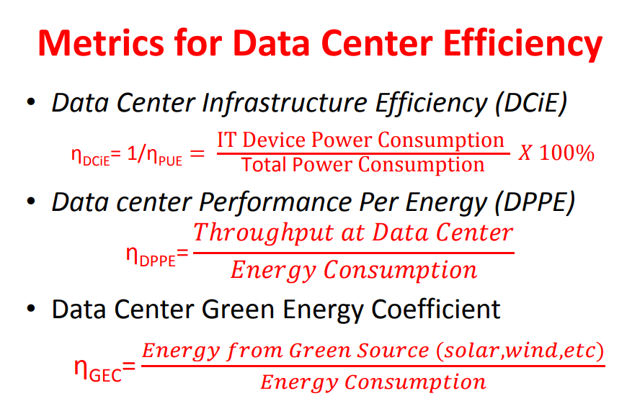
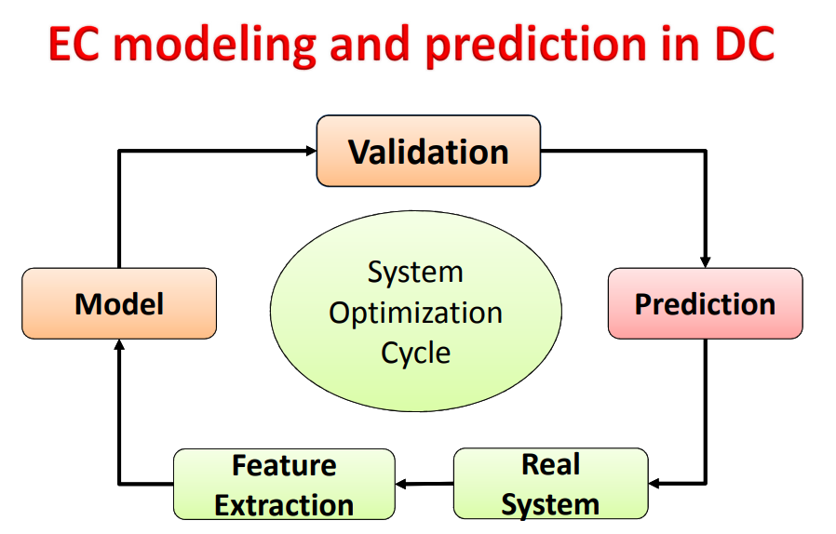
DATA CENTER INFRASTRUCTURE EFFICIENCY
=> IT / TOTAL * 100
More the IT device consumption in total more will be its efficiency as less invested on infra
DATA CENTER PERFORMANCE PER ENERGY
THROUGHPUT AT DATA CENTER / ENERGY
Data centre green energy :
Total green energy source / total power consumed

